Slide 1
Insights from Decades of Earthquake Data: SQL Analysis of Events from 1965 to 2016
Dr. Banuvathy Rajakumar

Slide 2
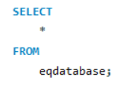
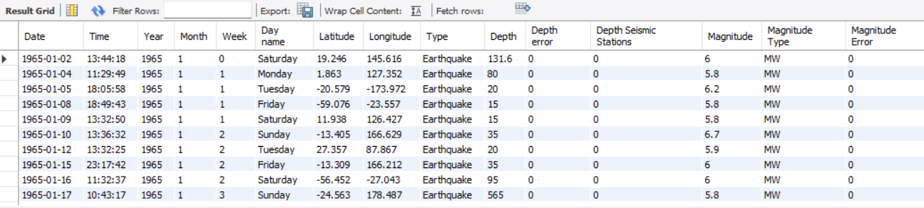
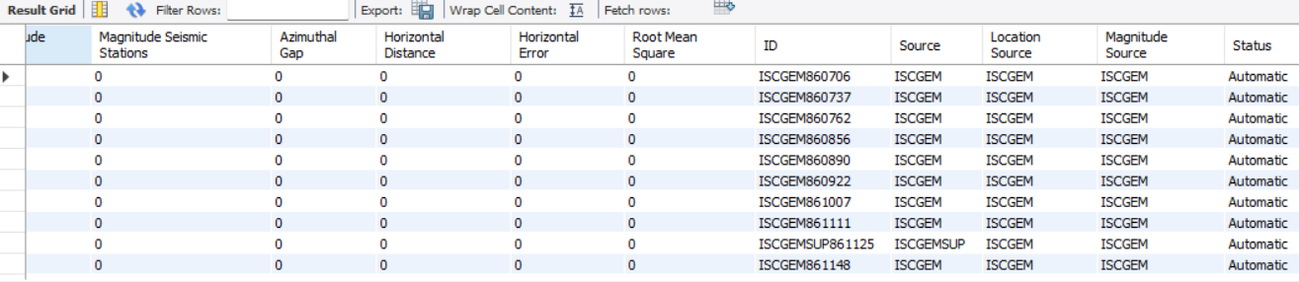
Data discovery

Slide 3
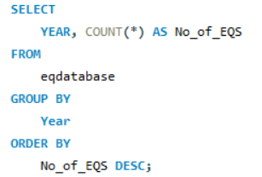
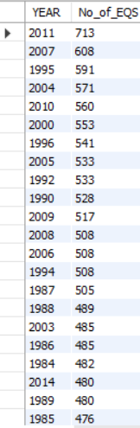
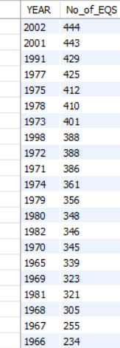
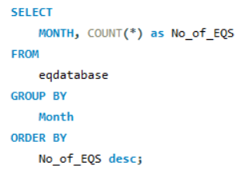
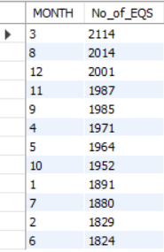
1) What is the distribution of earthquakes over different years and months?
Observation: Maximum number of Earthquakes (713) occurred in the year 2011 and Minimum number of earthquakes happened in the year 1966 between the interval 1965 and 2011.
Observation: March and July had a maximum number of Earthquakes followed by December and November

Slide 4
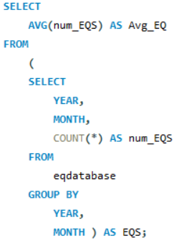

2) What is the average number of earthquakes per month?
Observation: On an average, 37 earthquakes occurred per month

Slide 5
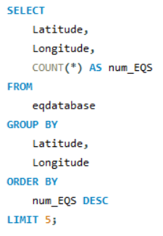
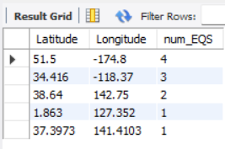
3) What are the top 5 regions with the highest number of earthquakes?
Observation: Latitude and longitude positions of first five areas with highest number of earthquakes are shown

Slide 6
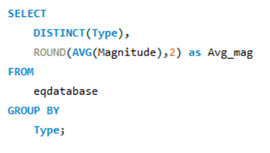
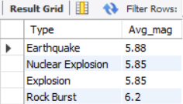
4) What is the average magnitude of earthquakes for each type?
Observation: Earthquakes due to Rock burst found to have a earthquake with average magnitude of 6.2

Slide 7
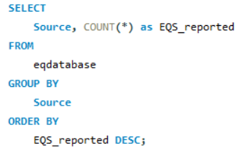
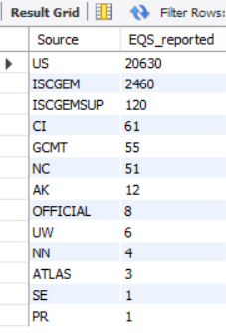
5) How many earthquakes are reported from each source?
Observation: University of Washington (US) reported the maximum number of earthquakes. It was then followed by International Seismological Centre Global Earthquake Model

Slide 8
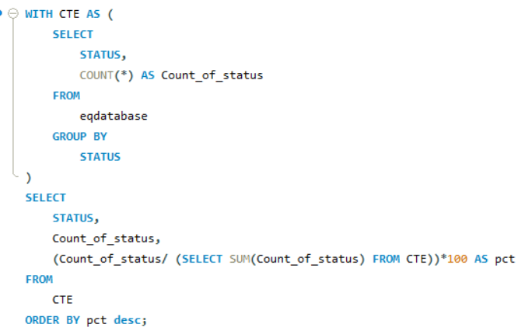
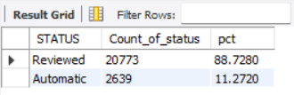
6) What are the different earthquake statuses and their frequencies?
Observation: Almost 88% of the earthquakes were reviewed while remaining 11% were in the form of Automatic or Preliminary reports.

Slide 9
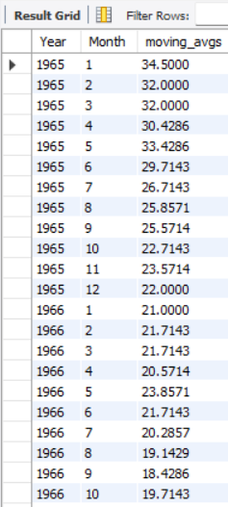
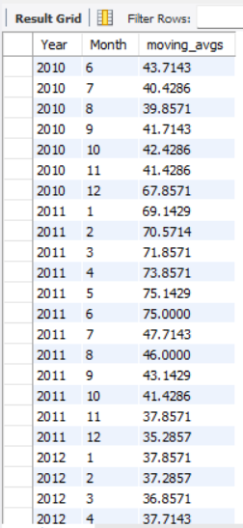
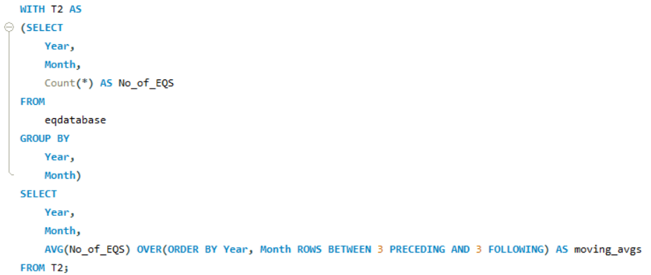
7) How does the frequency of earthquakes vary over time, considering rolling averages or moving averages?
Observation: Moving averages of number of earthquakes were found to be high for the first 6 months of the 2011

Slide 10
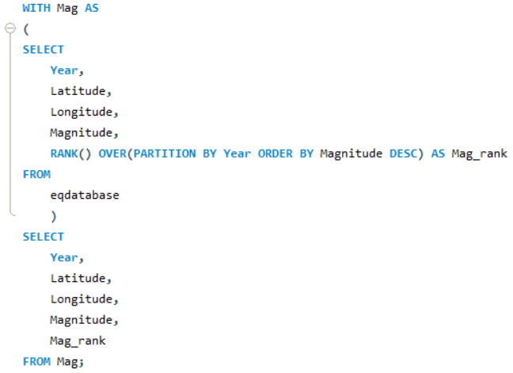
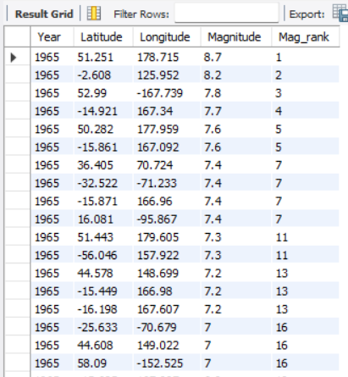
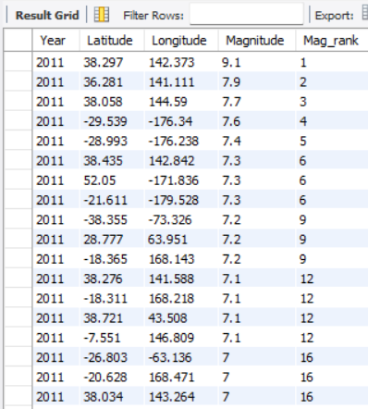
8) Can we rank earthquakes based on their magnitudes within each year?
Observation: By using Rank window function, tied rows will continue to have same rank while the consecutive ranks would be skipped for the following rows.

Slide 11
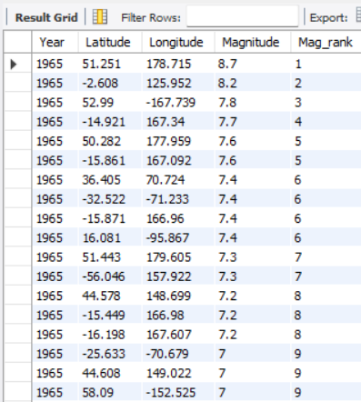
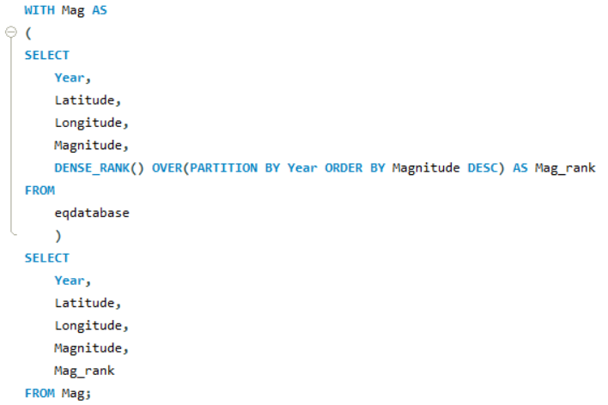
9) Using Dense_Rank?
Observation: By using DENSE_RANK window function, tied rows will continue to have same rank while the consecutive ranks would not be skipped for the following rows.

Slide 12
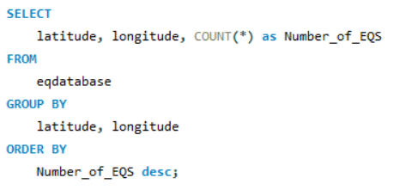
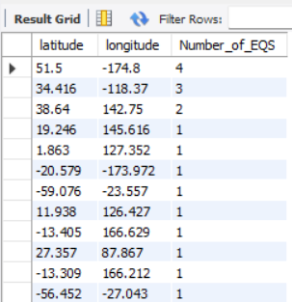
10) What are the top regions with the highest number of earthquakes?

Slide 13
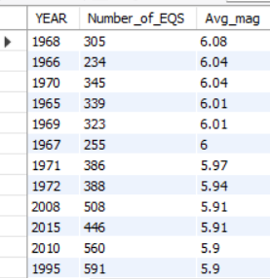
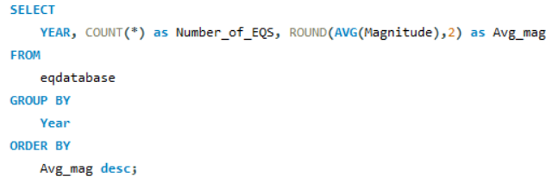
11) Average magnitude of earthquakes each year?
Observation: Although the number of earthquakes were 305 in 1968 (nearly half the number of EQS happened in 2011) , average magnitude of Earthquake was high compared to the other years

Slide 14
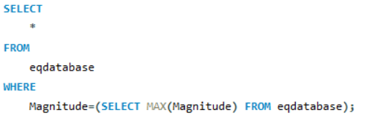
12) Highest magnitude of earthquake?
Observation: Highest magnitude of earthquake (9.1) occurred in 2004 and 2011

Slide 15
Insights
When analyzing the earthquake data between the year 1965 and 2016, maximum number of earthquakes (713) occurred in the year 2011 and minimum number of earthquakes happened in the year 1966.
March and July had a maximum number of earthquakes followed by December and November. Moving averages of number of earthquakes were found to be high for the first 6 months of the 2011. This shows that the first half of the year is more prone to earthquakes.
On an average, 37 earthquakes occurred per month.
University of Washington reported the maximum number of earthquakes. It was then followed by International Seismological Centre Global Earthquake Model.
Almost 88% of the earthquakes were reviewed while remaining 11% were in the form of Automatic or Preliminary reports.
In 1968, although the number of earthquakes were 305 , average magnitude of earthquake was higher compared to the other years.
Highest magnitude of earthquake (9.1) occurred in the year 2004 and 2011.

